Slide 1
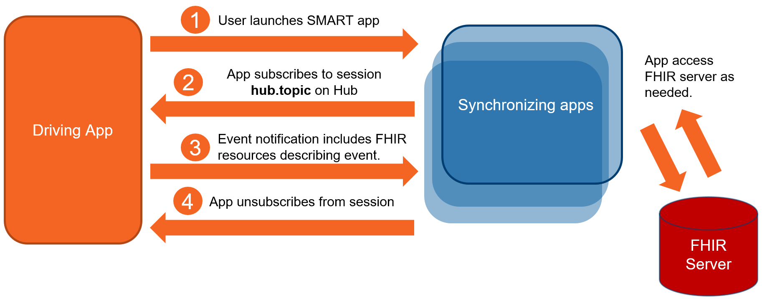

Slide 2
Driving Application
(such as EHR Worklist)
1
User launches Application for which Context Synchronization is Desired from Driving Application
recommended to use SMART App Launch including hub.url and hub.topic
Synchronizing Applications
Synchronizing Applications
Synchronizing Applications
FHIRcast Hub
Application Subscribes
to hub.topic
2
3a
Context Change Requests
with FHIR resources
3b
Context Change Events
with FHIR resources
Application Unsubscribes
from hub.topic
4
Logical View of FHIRcast Interactions

